Slide 1
ACT2111 Tutorial-Ch 9
ACT2111 Teaching Team

Slide 2
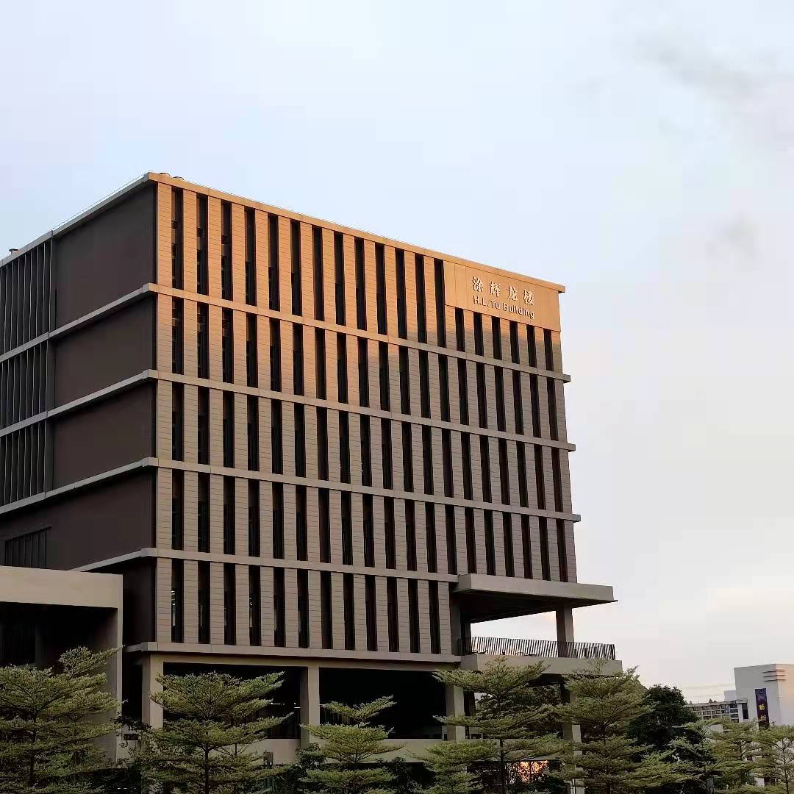
Content
Key Points of Chapter 9
Mind Tree of PPE & Intangible Assets
Plant Asset - Life Cycle of Plant Asset
Difficulties in Tutorial Questions
Credit by Andy

Slide 3
Life Cycle of Plant Asset
Here we use equipment as an example to show the typical journal entry of plant asset during the whole life cycle
Typical Journal Entry
1
Dr. Equipment (Based on Historical Cost Principle) $1000
Cr. Cash/Account Payable … 1000
Purchase
2
1. Ordinary Repairs
Dr. Repair Expense $200
Cr. Cash/Account Payable … 200
2. Additions and Improvement
Dr. Equipment $200
Cr. Cash/Account Payable … 200
Expenditures
Depreciation
3
Dr. Depreciation Expense (3 different methods) xxx
Cr. Accumulated Depreciation xxx
Disposal

Slide 4
Life Cycle of Plant Asset
Here we use equipment as an example to show the typical journal entry of plant asset during the whole life cycle
Typical Journal Entry
4
1.1 Retirement (zero book value)
Dr. Accumulated Depreciation - Equipment $1000
Cr. Equipment 1000
1.2 Retirement (positive book value, e.g. $100)
Dr. Accumulated Depreciation - Equipment $900
Dr. Loss on disposal of Plant Assets 100
Cr. Equipment 200
2.1 Sale of Equipment (Sales prize is higher than book value – Gain)
Dr. Cash $200
Dr. Accumulated Depreciation – Equipment 900
Cr. Equipment 1000
Cr. Gain on Disposal of equipment 100
Purchase
Expenditures
Depreciation
Disposal

Slide 5
Life Cycle of Plant Asset
Here we use equipment as an example to show the typical journal entry of plant asset during the whole life cycle
Typical Journal Entry
4
2.2 Sale of Equipment (Sales prize is lower than book value – Loss)
Dr. Cash $50
Dr. Accumulated Depreciation – Equipment 900
Dr. Loss on Disposal of equipment 50
Cr. Equipment 1000
Purchase
Expenditures
Depreciation
Disposal

Slide 6
Difficulties in Tutorial – Chapter 9

Slide 7
Thanks for your listening !

